Slide 1
Veeam Lab Guide

Slide 2
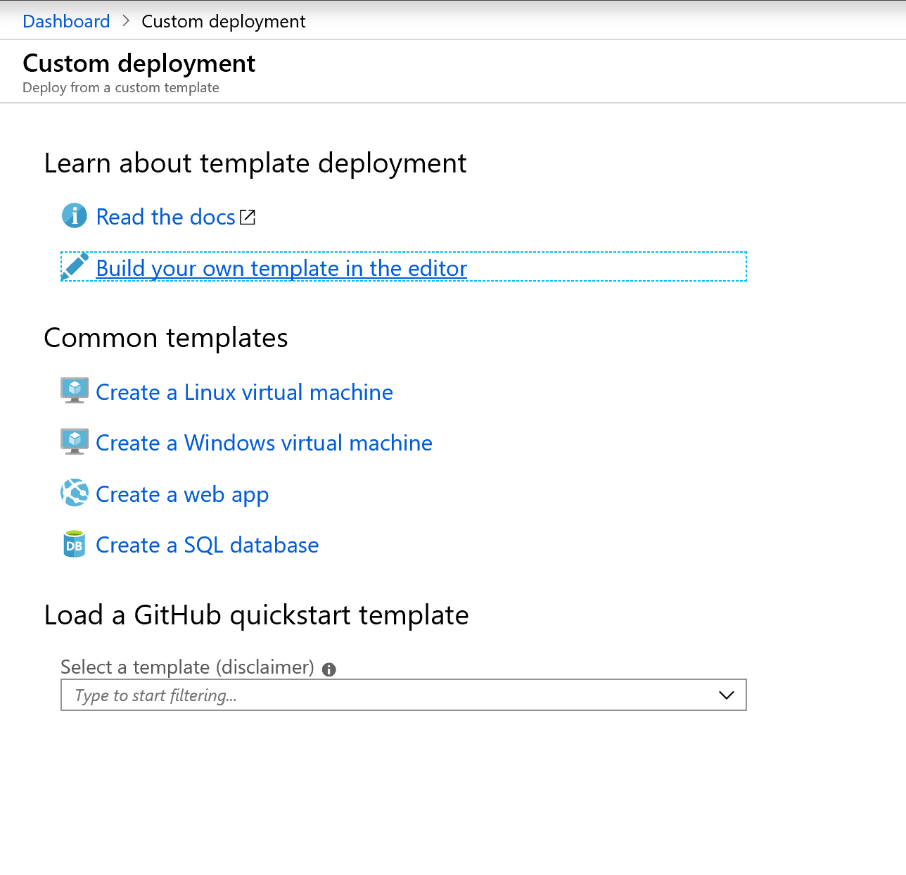
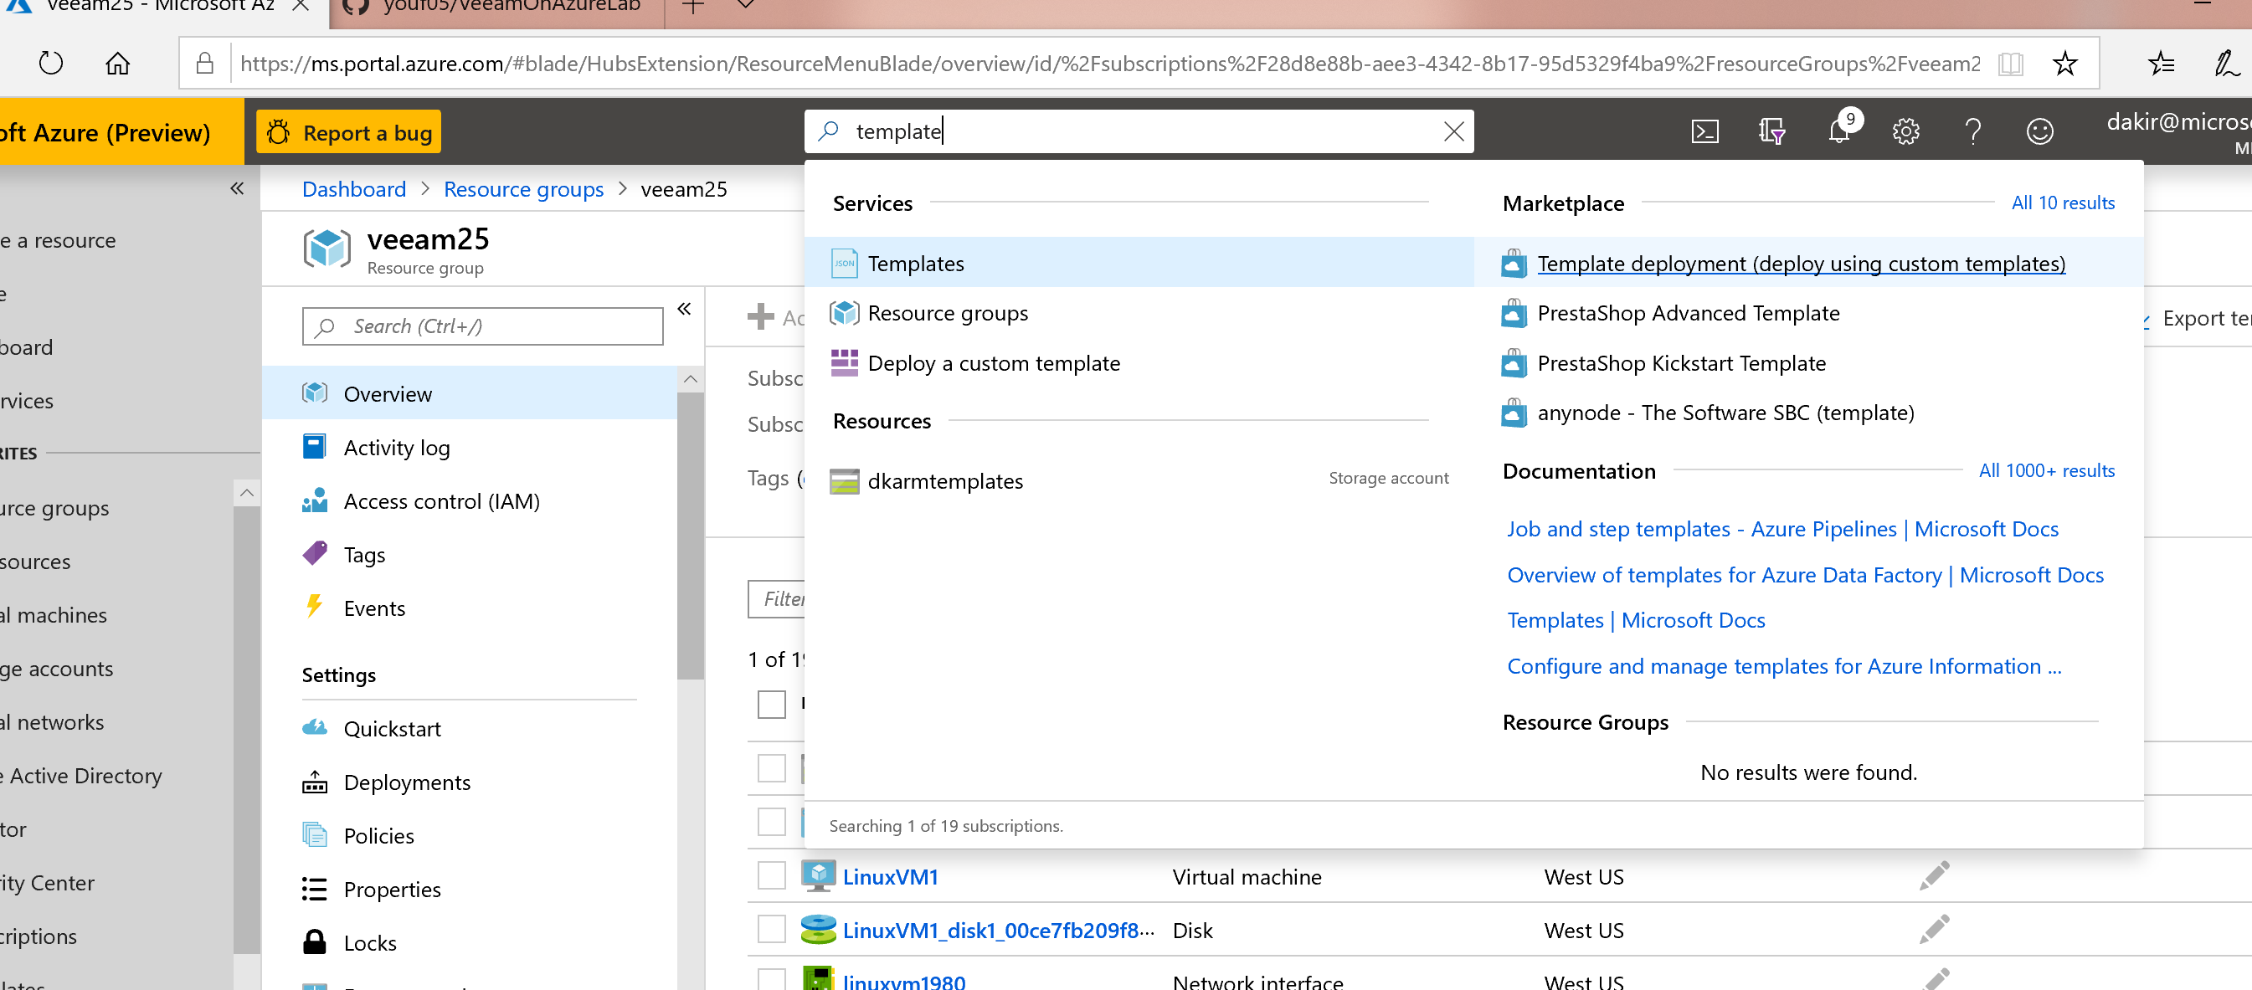
Lab Infrastructure Setup
Download ARM templates from Github repo
Optionally deploy directly from Github
Open portal.azure.com and search for “template” in the top search bar and choose “Template deployment”
Then select “Build your own template in the editor”

Slide 3
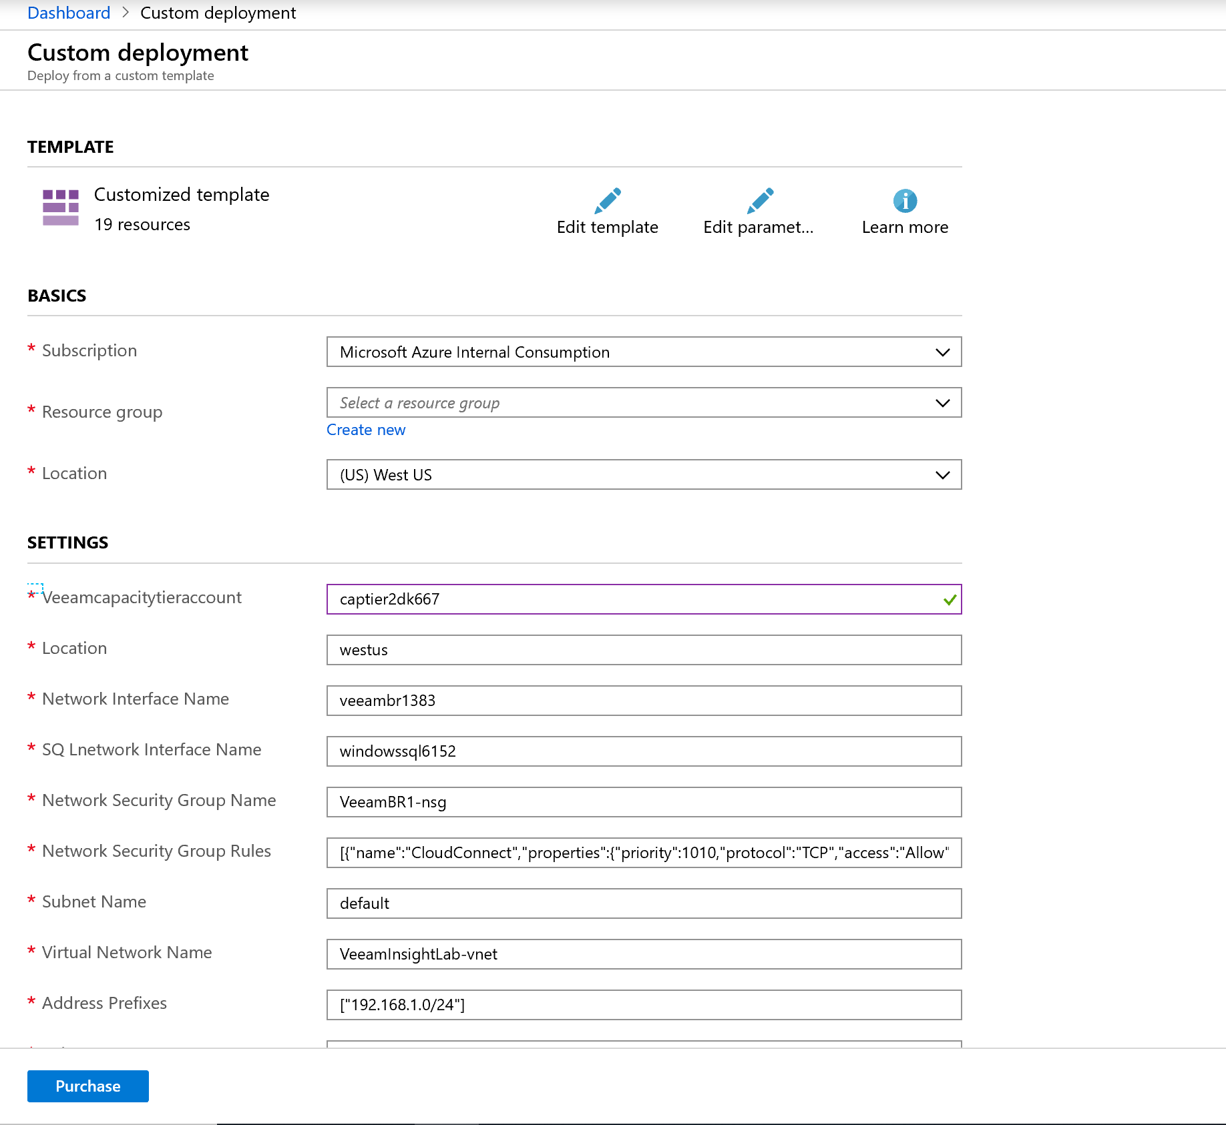
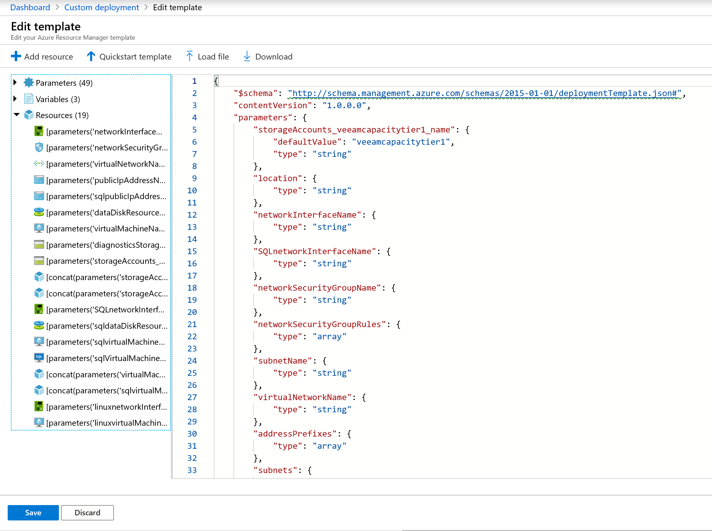
Select “Load File” and upload “VeeamLabTemplate.json”, then save
“Edit Parameters” and load the VeeamLabParameters.json”, then save
Create a new resource group and select it
Review the parameters and choose a globally unique name for veeamcapacitytieraccount -something like captier<yourinitials and bday> - don’t use special characters and use all lowercase
Leave all other parameters set to their defaults, including the location (West US region)
Click purchase to begin the deployment

Slide 4
During deployment
Register for Veeam B&R Trial (https://www.veeam.com/vm-backup-recovery-replication-software.html)
(optional) Install RDCMan if concerned about display scaling issues on high DPI devices - https://www.microsoft.com/en-us/download/confirmation.aspx?id=44989
Review Deployment architecture
Validate Azure deployment succeeded and record in notepad the following for later:
Name of your capacity storage account
Access key for the capacity storage account
Internal IPs for each of the servers deployed (VeeamBR, LinuxVM1, SQLVM1)

Slide 5
Azure Lab Environment
<diagram>

Slide 6
Veeam Components Review
B&R Console
Backup Server
Repositories
Direct Attach/On-Prem
Object Storage - Azure
Scale Out Repo = “On-Prem” + Object Storage tiering
Other concepts
Proxies
etc

Slide 7
Veeam License and Registration
RDP into VeeamBR (get connection info from azure portal)
Browse to Veeam.com and download trial license key you registered for earlier
Start B&R Console and register license

Slide 8
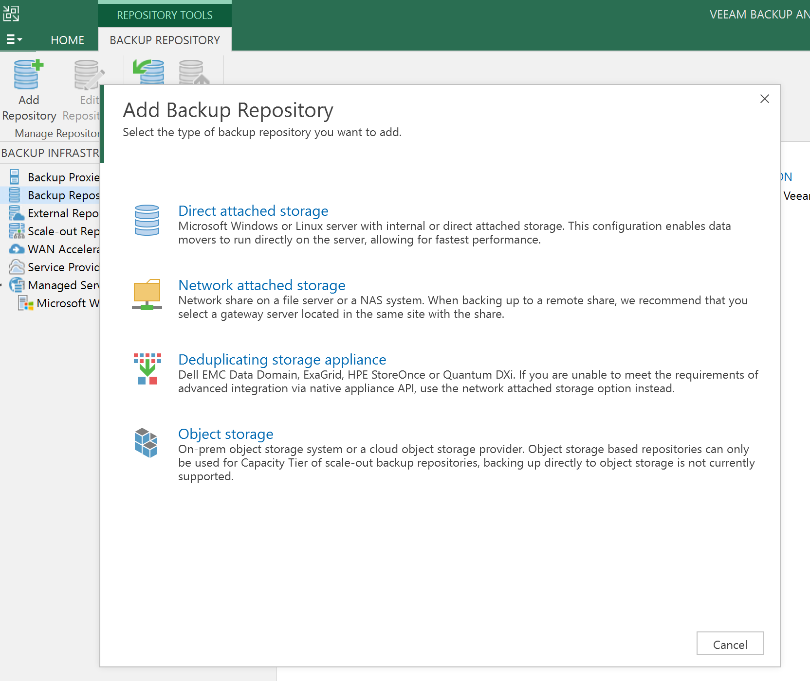
Configure Veeam Primary Repo
Add primary backup repo (“on prem”) as direct attached storage
Select F drive as backup repo location
Use defaults for all other options
Do not change config backup to new repo

Slide 9
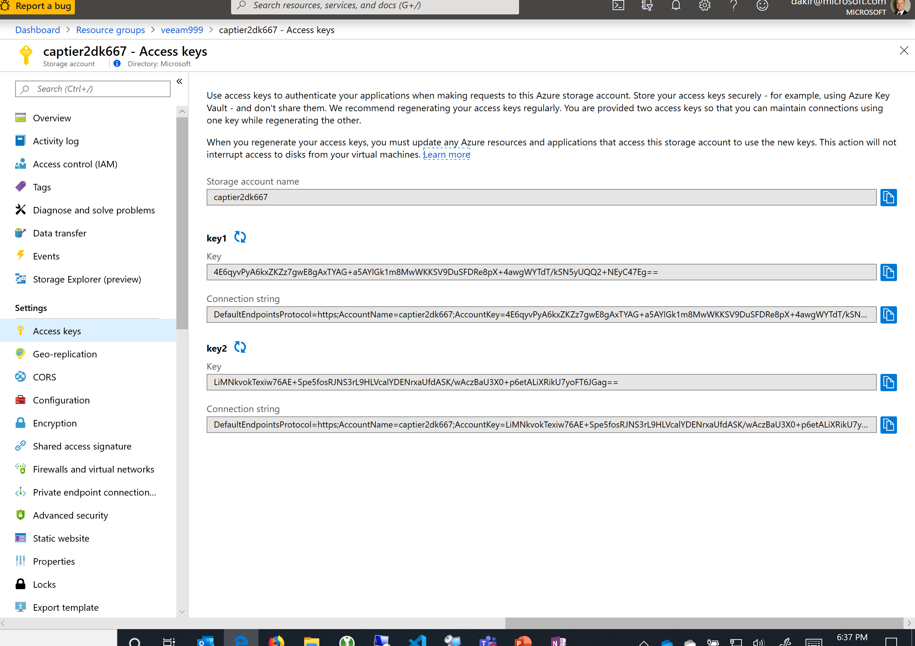
Configure Azure Storage Credentials
Select Manage Cloud Credentials from top left menu
Add->Azure Storage
Provide the name of your capacity tier storage account
Provide one of the access keys (get it from the “Access Keys” blade on the storage account resource in Azure Portal)

Slide 10
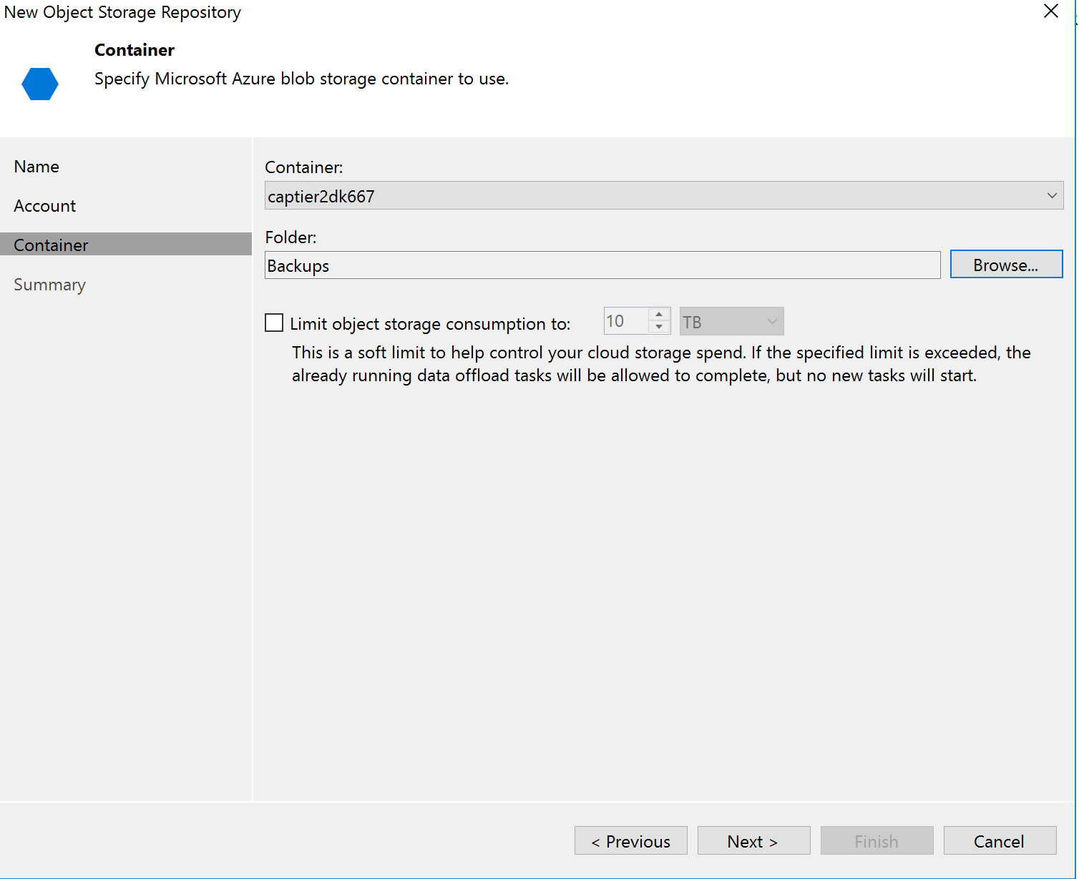
Configure Azure Storage Repo
Add another backup repo and select Object Storage
Use the credentials you just added and select your storage account
On the Container section of the wizard, browse your storage account and create a new folder called “Backups”
Click “Finish”
You should now have 3 repos listed in the Veeam console under Backup Repositories

Slide 11
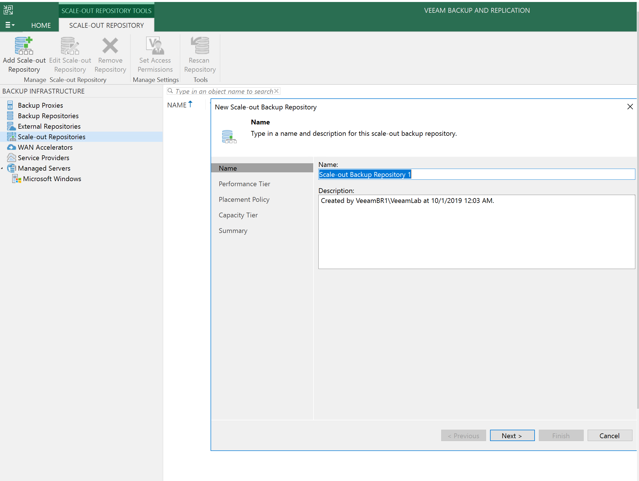
Add Scale Out Repo
Go to Scale-Out Repositories and start the Add Scale Out Repo wizard
Under Performance Tier, select the new “on-premises” repo you created first
Under Capacity Tier, select the Azure Storage repo
Choose defaults for everything else and finish the wizard
Vnet service endpoints avoid egress costs

Slide 12
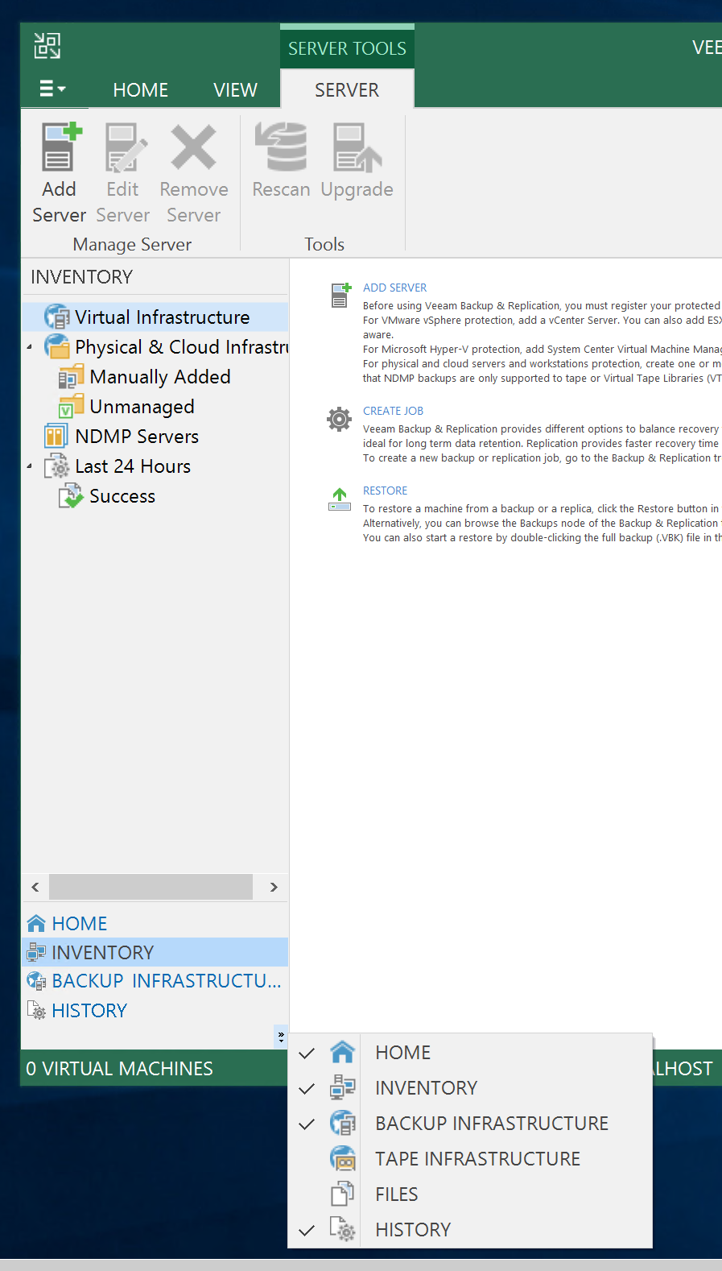

Enable additional Veeam views
In the bottom left of Veeam console, click on the small arrows and turn on the following views:
Home
Inventory
<optional> Tape Infrastructure
<optional> Files

Slide 13
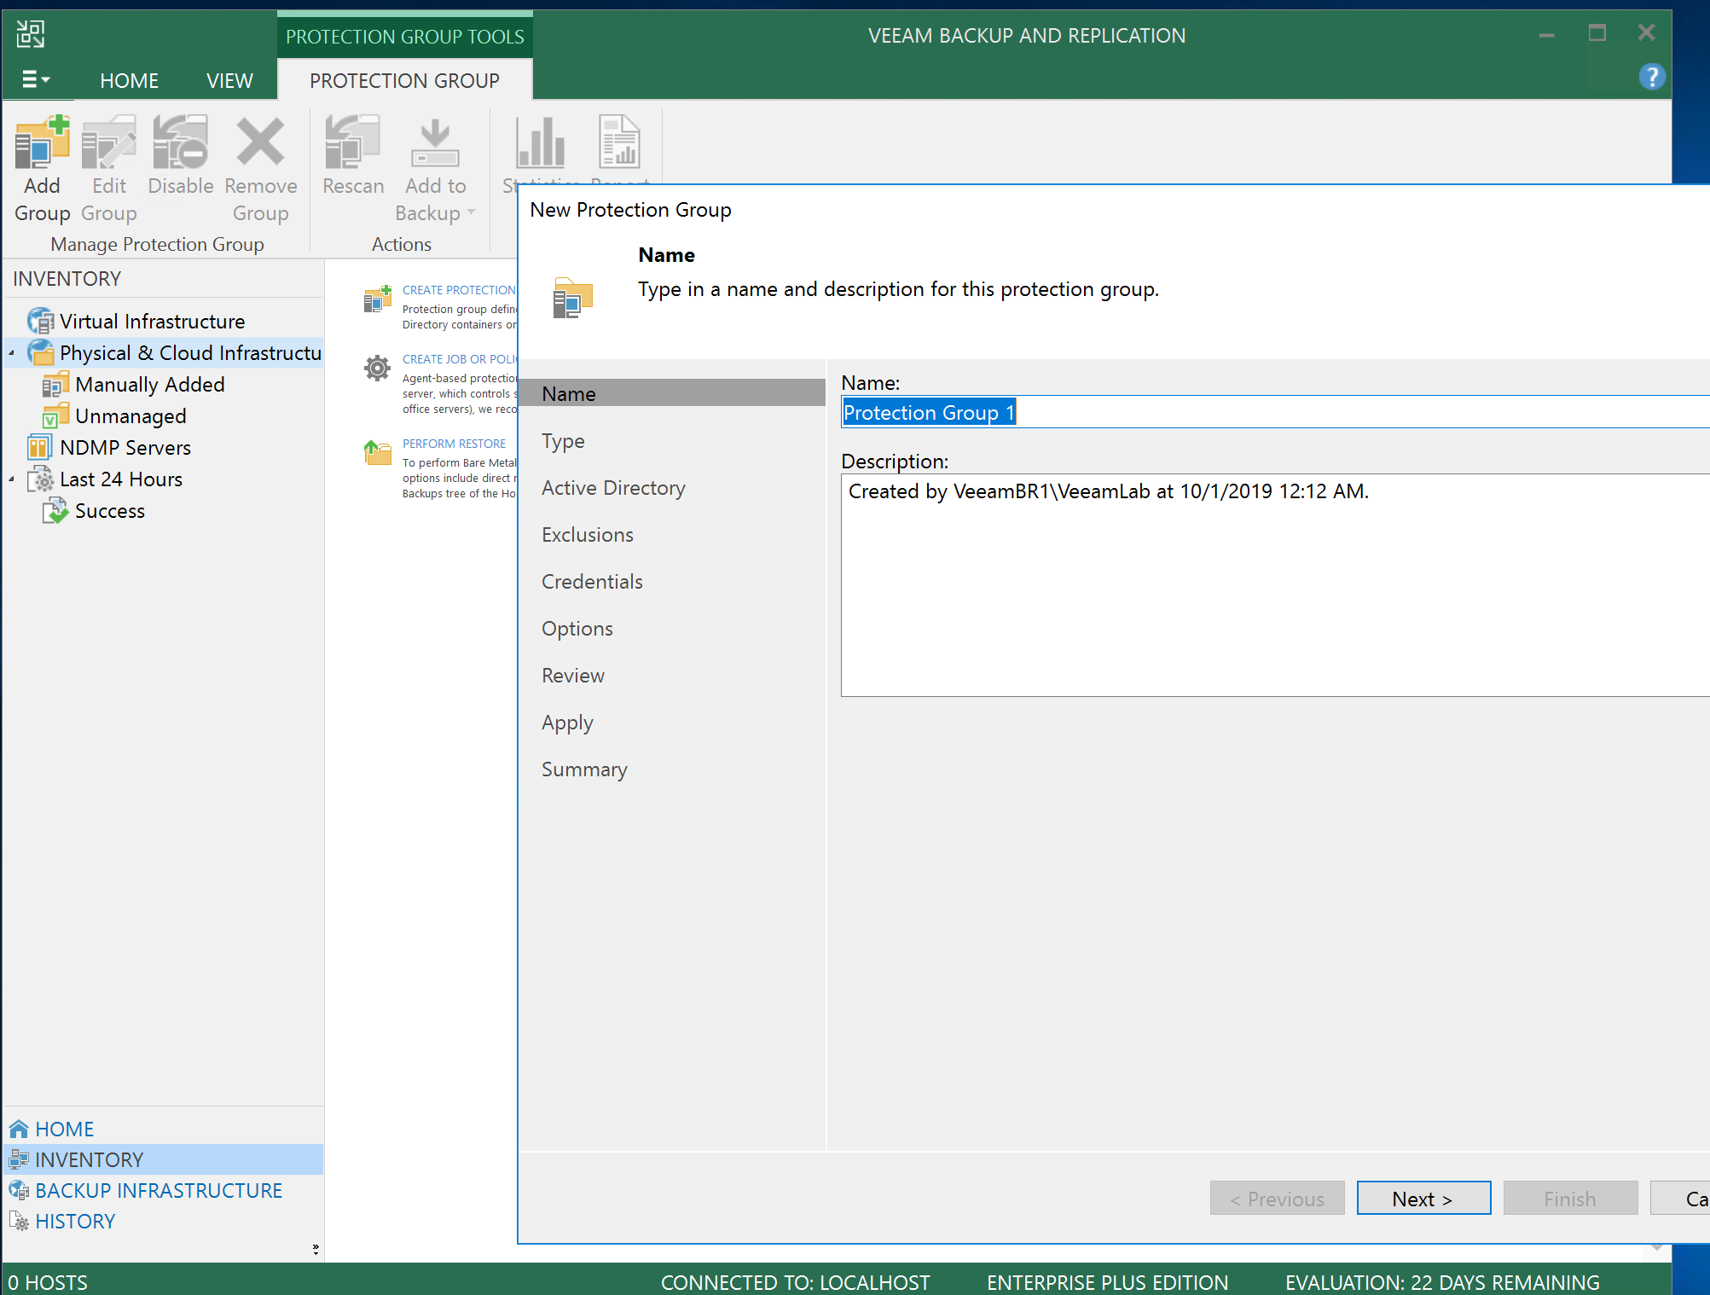
Add backup sources into a protection group
Open the Inventory view and select “Protection Groups”
Start the Add group wizard
Follow the wizard to add servers by IP address.
You will need to create two credential entries to authenticate into the source servers
One Windows credential for the SQL VM
One Linux credential for the Linux VM
Default creds are:
Username – VeeamLab
Password – Pass@word123!
Note that Linux usernames are case sensitive
Select Non-root account checkbox for the Linux credentials
Add servers by internal IP address (check in Azure portal under vnet resource to get addresses)
Finish the wizard with default options and monitor progress as agents deploy

Slide 14
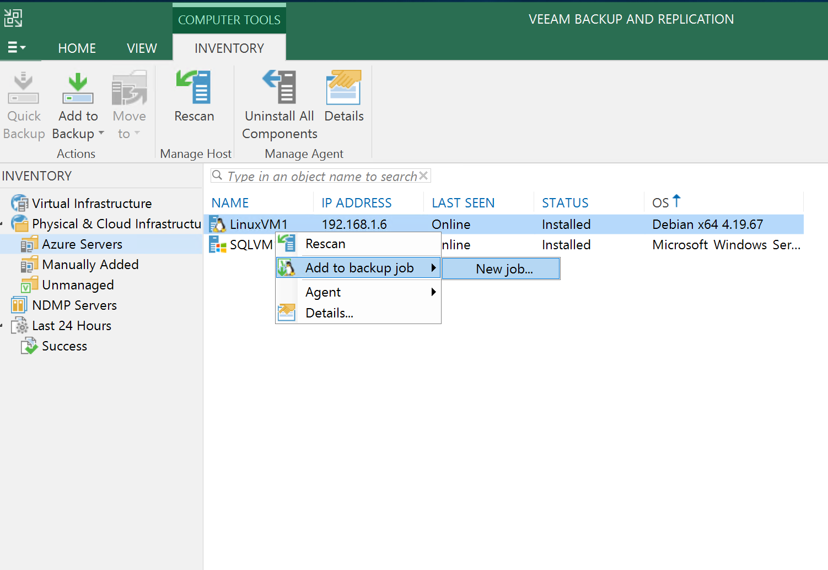
Create a Backup Job on LinuxVM1
Under the protection group, right click LinuxVM1->Add to backup job->New Job
In the wizard, select Type: Server and Mode: Managed by Backup server
Backup Mode: Entire computer
Storage: Select the Azure Scale out repo you added earlier

Slide 15
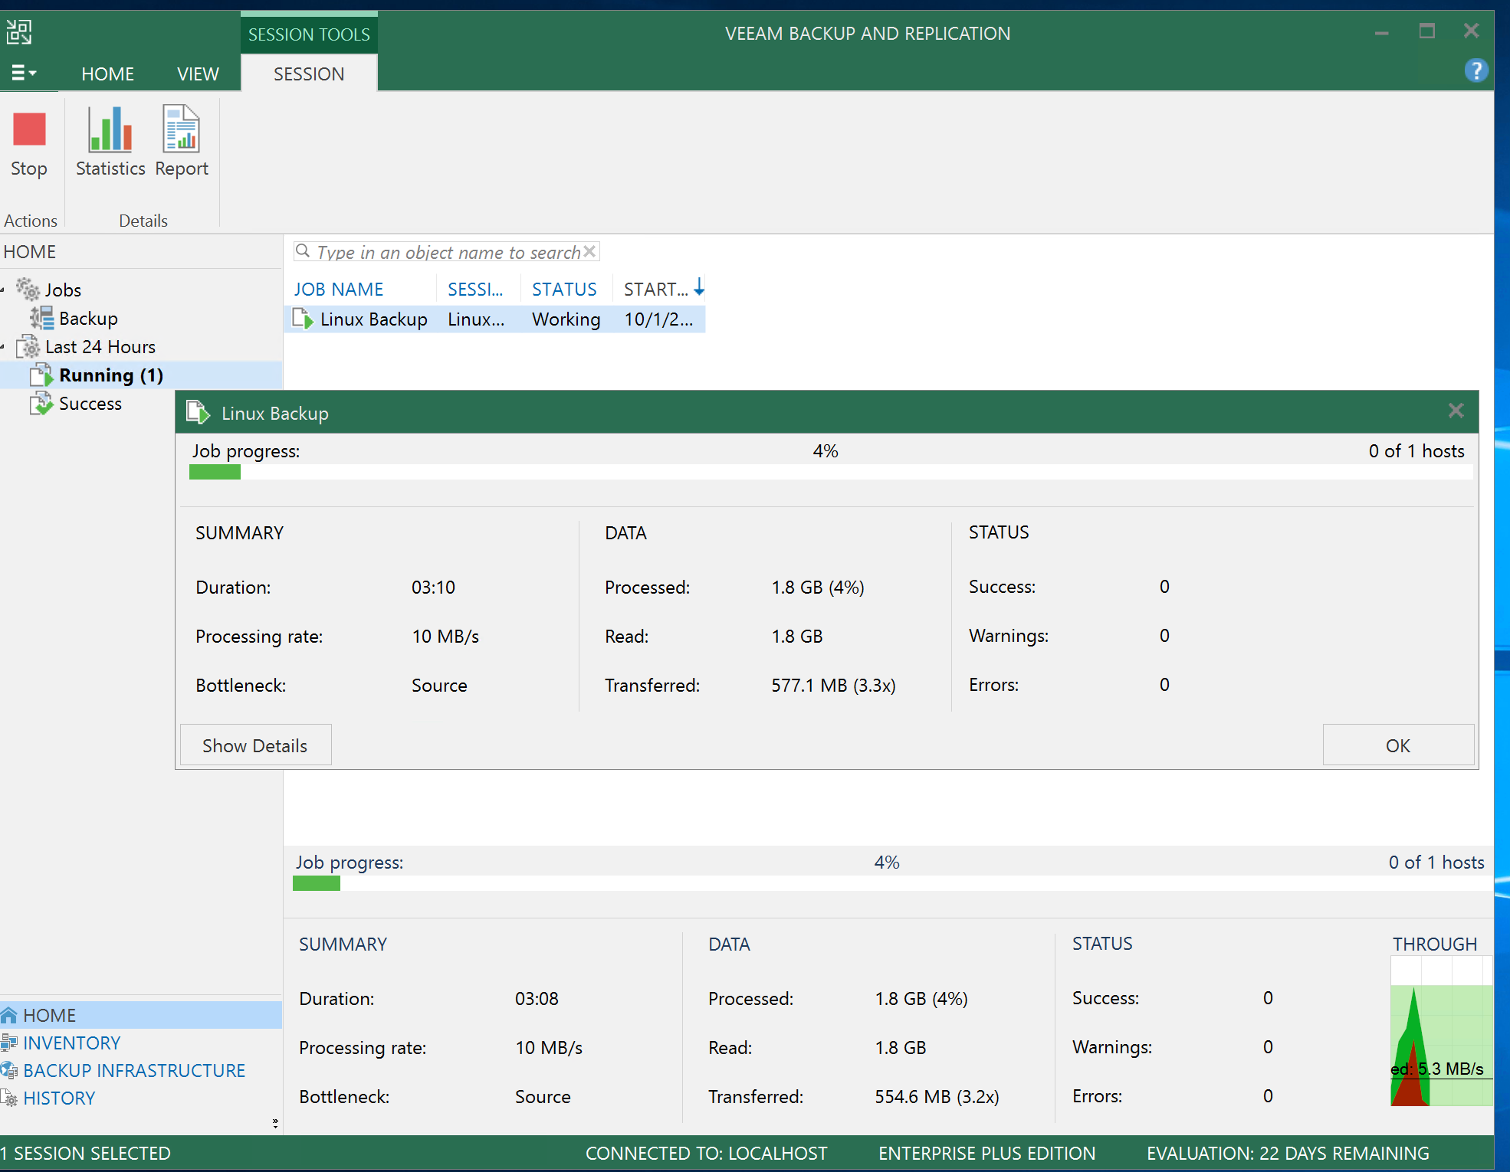
Monitor Linux backup job
Under Home view in Veeam Console, open the running Linux backup job and monitor progress.
You can use this view to check errors on failed jobs, get statistics, etc.

Slide 16
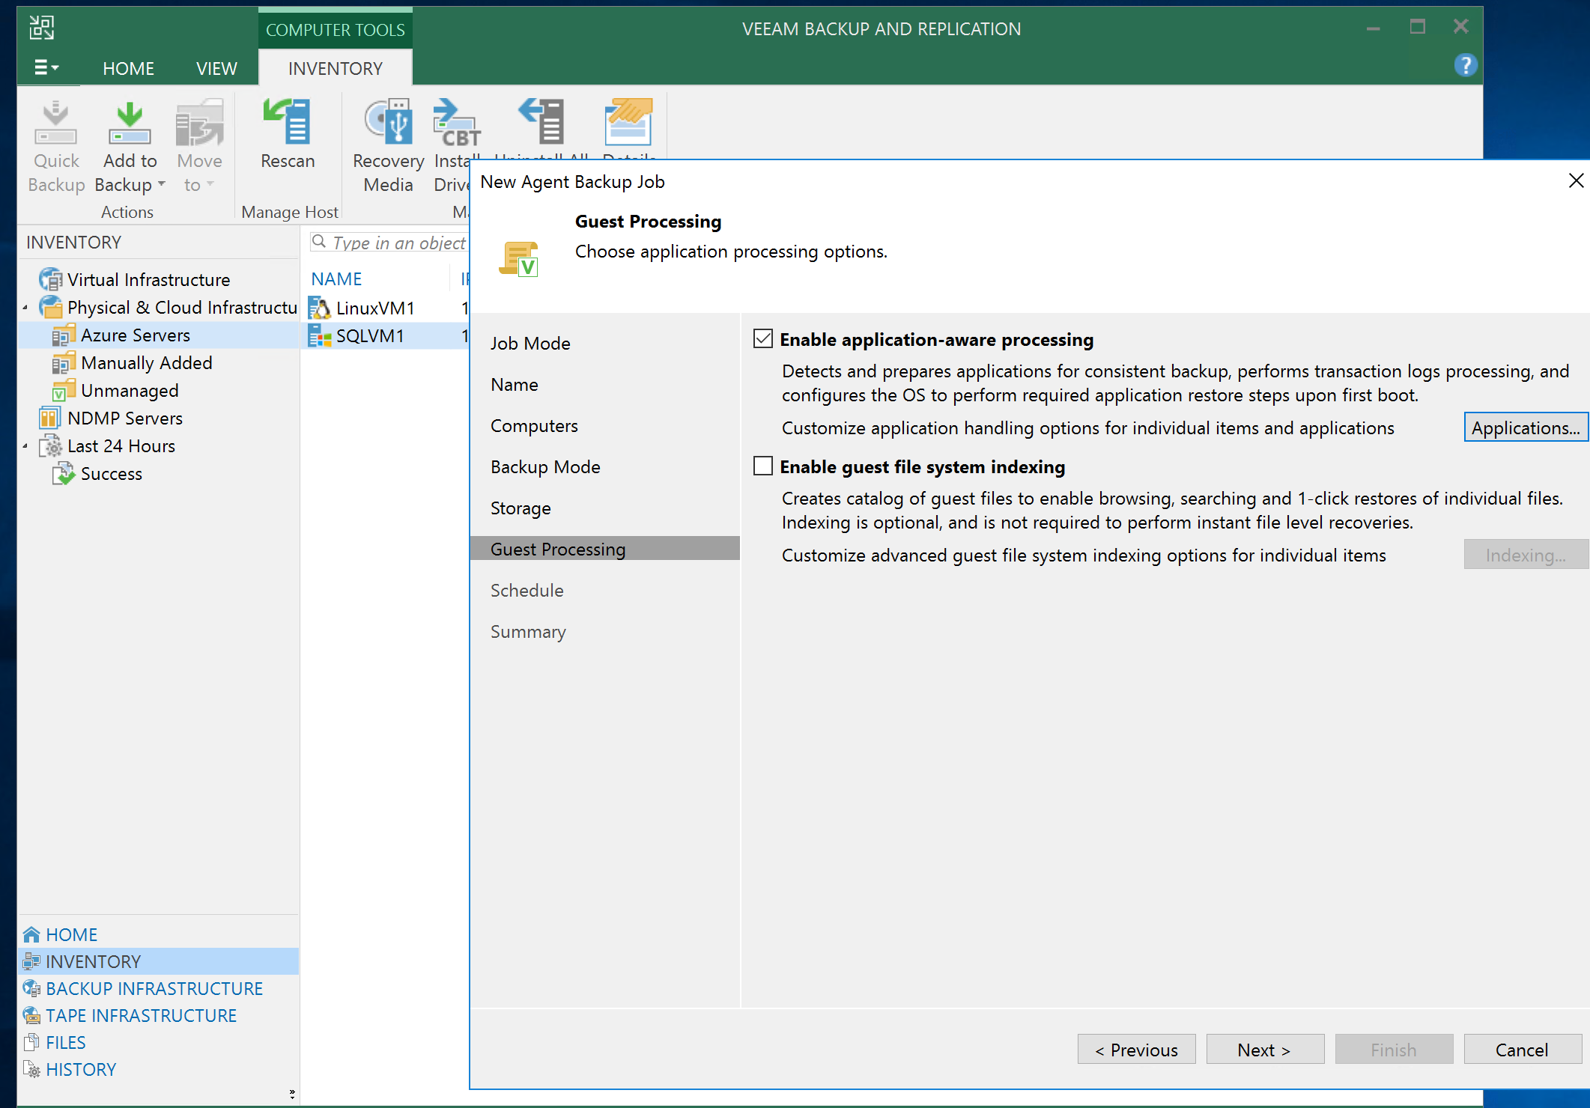
Create SQL Backup Job
Follow similar steps to add a backup job to the SQL VM
Choose Azure backup scale-out repo
Explore Application Aware options. Veeam intelligently handles things like SQL transaction logs, Oracle, SharePoint, and pre- and post- scripts for custom workloads
Finish the wizard and run the backup job
Note: you can add multiple VMs to a single job. Consider grouping VMs by workload, storage target, priority, etc. Backup strategy should be discussed with customer and informed by knowledge of existing environment, protection goals (RPO/RTO), cost goals, etc)

Slide 17
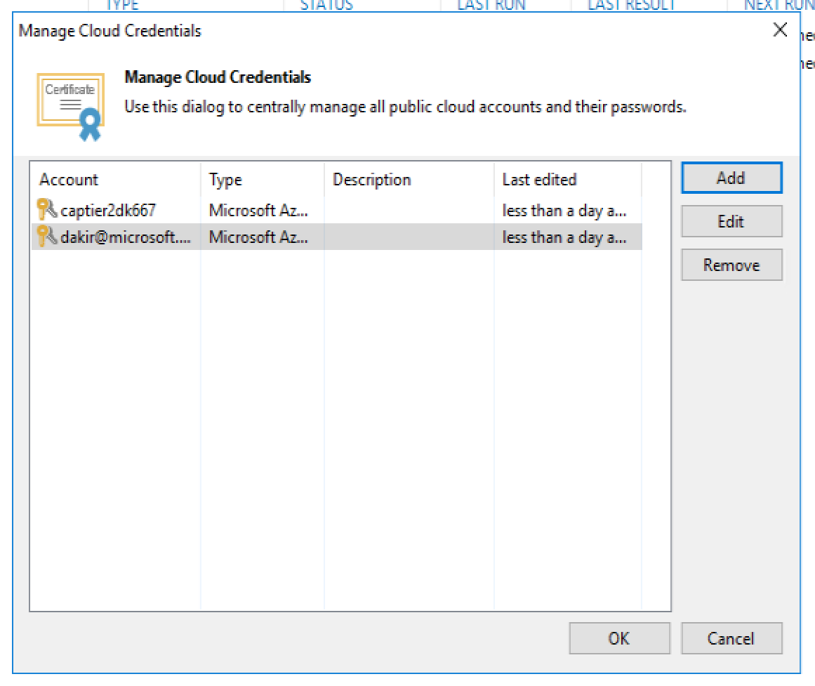
Configure Azure Compute account
Open the Manage Cloud Credentials wizard
Add an Azure Compute account by supplying the same credentials you are using to authenticate into your Azure subscription
The AAD account you supply must have rights on the subscription to create new resources including groups, VMs, storage accounts

Slide 18
Configure Azure instant restore landing zone
We want to create a landing spot for VMs restored to Azure in advance of doing a restore
From the Azure portal create the following:
New resource group
Standard storage account (LRS)
Virtual network and subnet (place in the new resource group you just created)
NSG (optional)
When we perform the Restore to Azure from Veeam console, we will target this landing zone as a spot for our restored VMs to instantiate

Slide 19
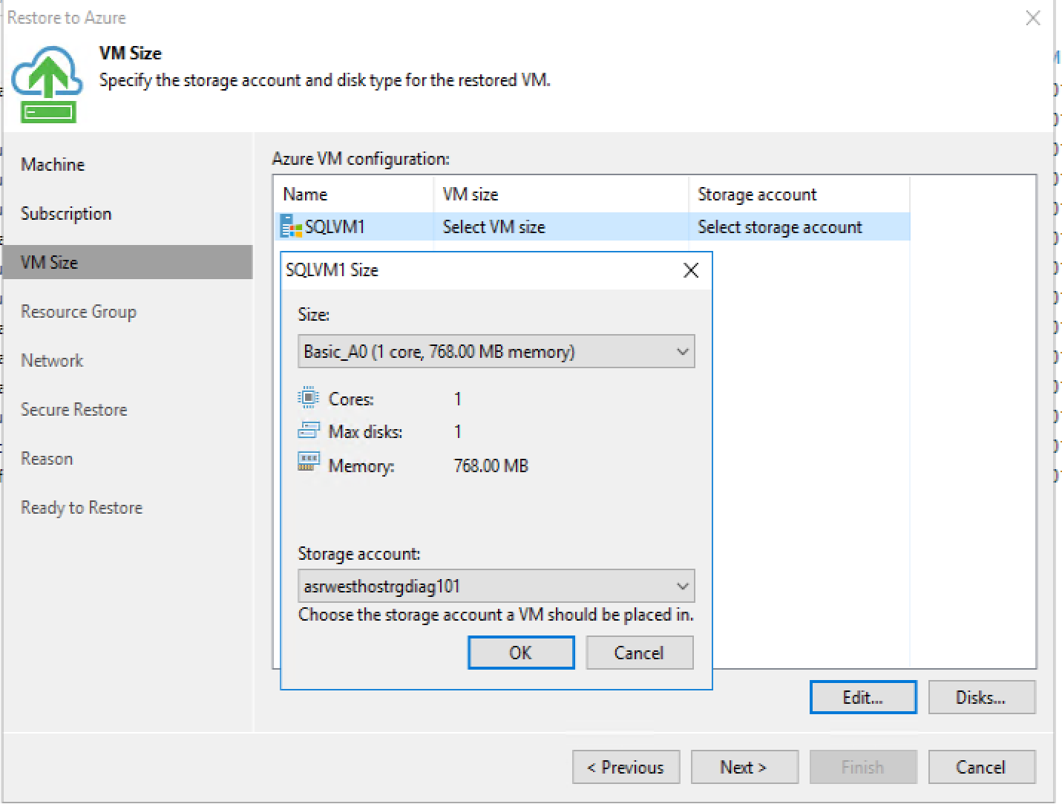
Start a restore to Azure from Veeam
From the Home tab of Veeam console, select Restore->Agent
Select Entire Machine restore and review options
Select Restore to Azure
Follow the wizard to complete the restore
Use either the SQL or Linux VM as your source
Select the Azure compute subscription you registered earlier
Choose an appropriate VM size (recommend D2v3)
Select the storage account you just created
Give the restored vm a unique name
Select the resource group you just created as the rg
Select the Vnet you just created
Start the restore
The machine will now be created in Azure
This process can be used to easily migrate VMs to Azure permanently

Slide 20
Prepare for Linux guest file restore (optional)
Veeam uses a helper appliance VM to perform guest-level file restores from Linux servers. We will configure Hyper-V on the Veeam B&R server to host this helper appliance
Open Hyper-V Manager and add a new Internal vSwitch using default values
In the Veeam console, register the local server as a new Virtual Host
We’ll walk through this one together.
TODO: work out display issue for adding host
You may need to change your display sizing down to 100% for this step if you are on a high DPI device

Slide 21
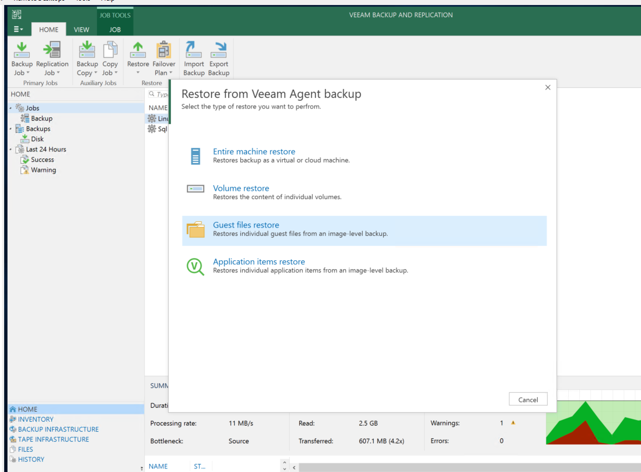
Perform a Guest file restore from Linux backup (optional)
From Home tab, click Restore->Agent
Choose Guest files restore and then choose from Linux
Restore Guest VM to Azure

Slide 22
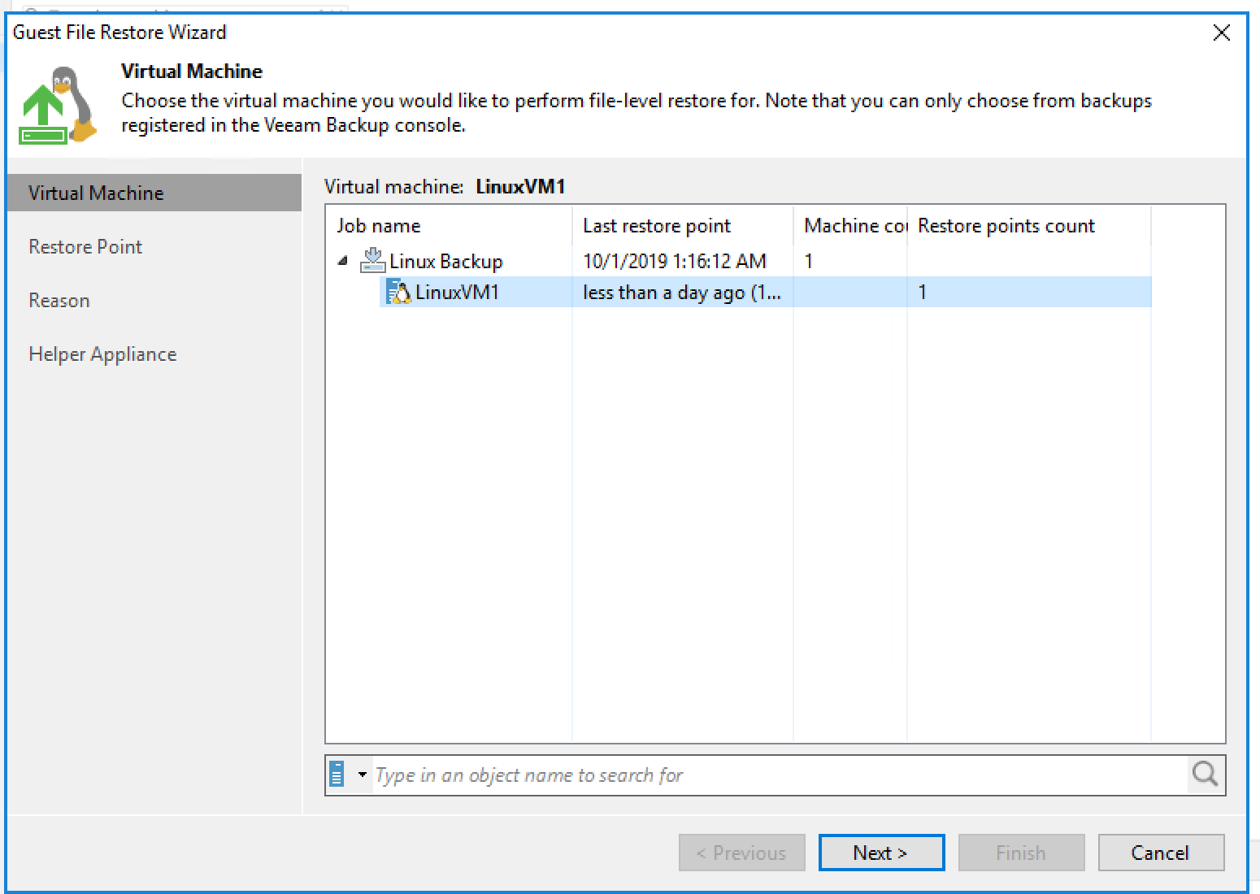
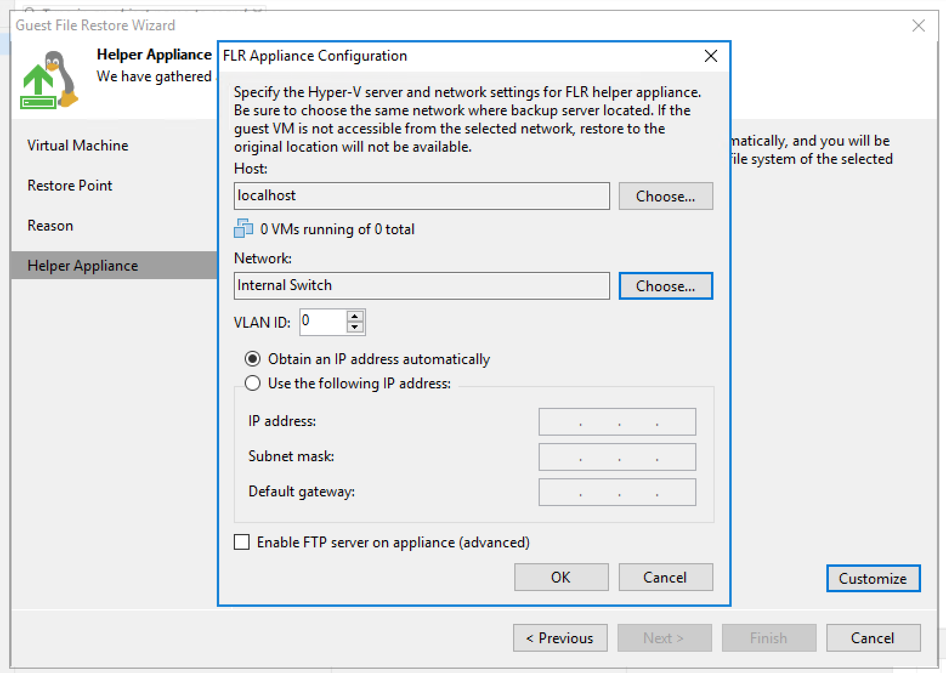
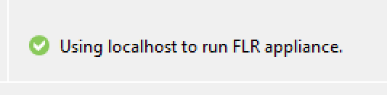
Perform a Guest file restore from Linux backup (optional)
On the Helper tab of the wizard, click “Customize”
“Choose” the localhost you added as a Hyper-V host and the vSwitch you created earlier
Run ipconfig from cmd.exe and get the vSwitch ip assigned to the host
Assign an IP of 169.254.xx.xx; avoid conflict with host; use the host IP for the vEthernet adapter as the default gateway for the appliance
The vSwitch you created should be automatically selected.
If successful you should see this at the bottom of the wizard.
Click finish.
Choose the LinuxVM and then choose a restore point. Optionally provide a reason.

Slide 23
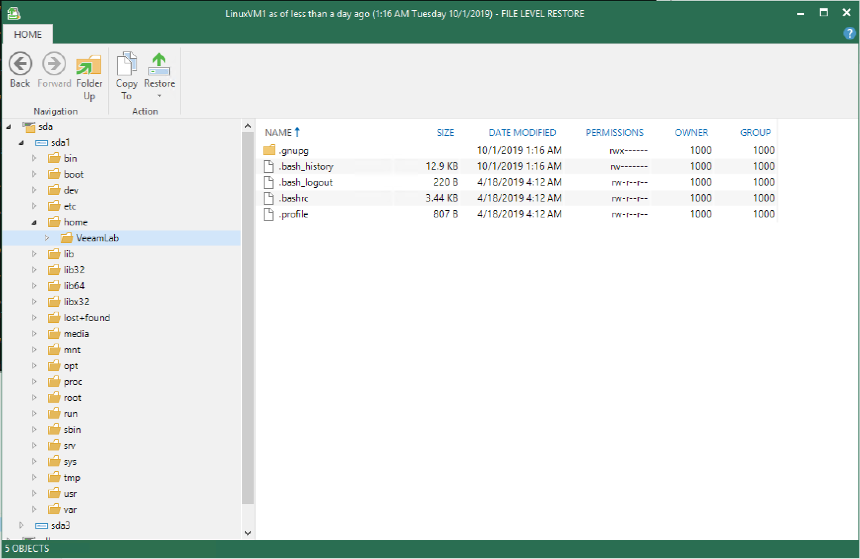
Browse Linux backup file system directly from Veeam and copy files as needed
If you successfully completed the Linux guest restore steps, you will now be able to browse the files of the Linux backup directly from the Veeam console
Backup admins can use this to easily move specific files from backup snapshots to source without taking the source offline or waiting for a full restore.

Slide 24
Demo of replication job
Kurt to demo Datacenter1->Datacenter2 replication
Discuss warm standby; comes online in a few minutes
RPO/RTO

Slide 25
Clean up lab resources
Delete the resource group created in the lab setup
Verify all resources removed

